Slide 1
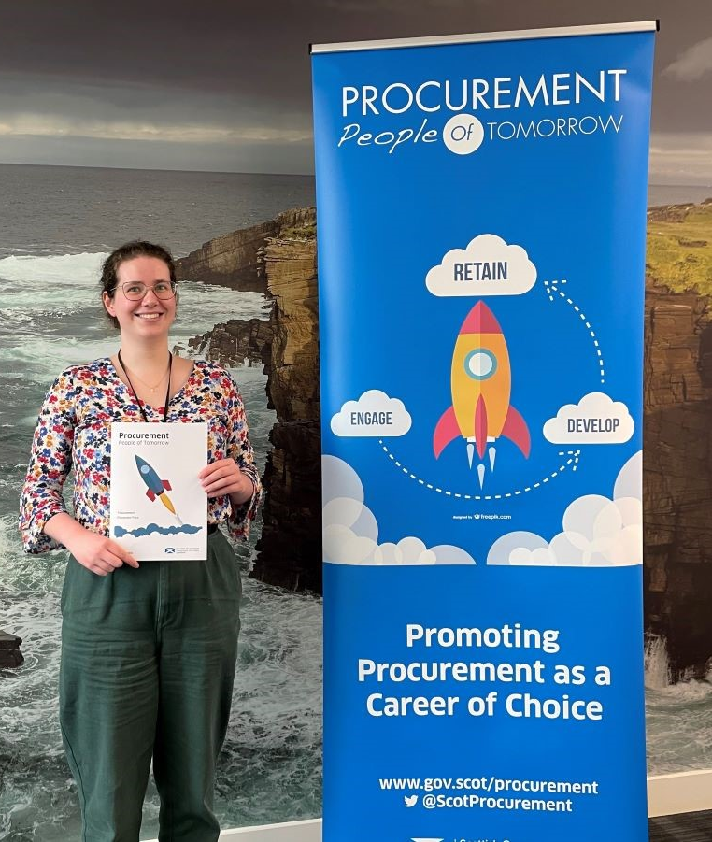
Case Studies Pack
Modern Apprentices
Procurement Graduates
Internships
Career Changers
Employer Perspectives
Progress of our people

Slide 2
Modern Apprentice
Jack Graham
Procurement Modern Apprentice
Scottish Government
Procurement Assistant (A3)
Procurement Delivery Job Family
This was the Case Study for Jack in 2021. You can see where he has progressed his career in the Progress of our People section
Who am I?
I am a 2:1 Honours Graduate from the University of the West of Scotland where I studied Society, Politics and Policy.
I wanted to be able to use my knowledge from my degree – regarding modern society and social policy – to good use in whichever job I would find for myself after graduating. Through job fairs and websites I learned about, and was successful in applying for, the Procurement Assistant Modern Apprenticeship, which incorporated passions within and outwith my degree.
Where am I?
I joined the Scottish Government as a Procurement Assistant in February 2019 working with the ICT Networks team. Having been in post for almost a year I am nearing completion of my SVQ3 Procurement qualification, despite delays caused by the COVID-19 pandemic. Nevertheless, I am enjoying the work.
What do I like about my role?
What I like best about my role is the team that I get to work with. The team is a fountain of knowledge regarding ICT Networks and procurement as a whole. Working in this team has only been beneficial for me – it has allowed me to learn from great professionals and apply what I have learned into my own work.
The learning aspect of the role also can’t go unnoticed either as I am able to gain a brand new, vocational qualification evidencing my skills, whilst also working in a job at the same time.
What have I been doing?
Since joining Scottish Procurement, I have been involved in
The new Mobile Voice & Data Services Framework introduced by the ICT Networks team.
Recording management information data from suppliers regarding spend and savings.
Regularly managing applications on Public Contracts Scotland – Tender (PCS-T) on whether companies gain successful access to the frameworks the ICT Networks team offer.
Facilitating and helping monitor the Knowledge Hub website, which allows users to access pricing schedules and documentation for our frameworks.
Where am I going?
Upon completion of my procurement qualification, I will be actively looking for the next step in my procurement journey.
Another longer-term goal within procurement would also be starting working towards my CIPS qualification as well.
2021

Slide 3
Modern Apprentice
Rachael Hughes
Procurement Modern Apprentice
Scottish Government
Procurement Assistant (A3)
Procurement Capability Job Family
This was the Case Study for Rachael in 2016. You can see where she has progressed her career in the Progress of our People section
Who am I?
Before becoming an MA in Procurement I attended Earlston High School in the Scottish Borders. I then went on to achieve an honours degree in Criminology and Sociology from Stirling University. After graduating job prospects were difficult and I was not sure what I wanted to do for a career.
Where am I?
I visited Skills Development Scotland’s “My World of Work” website and started looking into Modern Apprenticeships. I then applied for the Modern Apprenticeship in Procurement and was lucky enough to get the post in Scottish Procurement’s Learning and Skills team in May 2014.
What do I like about my role?
I would definitely recommend the Modern Apprenticeship in Procurement as it has been a great opportunity to gain new skills, experience and achieve qualifications while working.
I completed my Procurement SVQ 3 in June 2015, which involved many different placements across the directorate. Continuing my studies I sat the final exam for my Level 2 CIPS Certificate in Procurement and Supply Operations in May 2016.
I have learnt an incredible amount working in the Scottish Government. The experience of “earning and learning” has given me great insight and practical experience in all areas of procurement and allowed me to actively engage with CIPS.
What have I been doing?
Since joining Scottish Procurement, I have been involved in
organising procurement and commercial training courses and analysing performance data, as well as liaising with suppliers and raising payments
procurement policy issues and helping with Parliamentary Questions, First Minister Questions and ministerial briefings
procuring services while on placement with the Scottish Government procurement team.
In December 2014 I was a finalist in the Emerging Talent Category at the Scottish Public Service Awards.
Where am I going?
On passing my CIPS Certificate I plan to continue studying towards MCIPS, with CIPS Level 4 as my next goal.
I keep learning new skills and gaining new experiences through working in procurement in the Scottish Government and can now see this being what I want to do for a career.
2016

Slide 4
Modern Apprentice
Angus Mackenzie
Procurement Modern Apprentice
Scottish Government
Procurement Assistant (A3)
Procurement Delivery Job Family
This was the Case Study for Angus in 2017. You can see where he has progressed his career in the Progress of our People section
Who am I?
After finishing my last year of high school I had no plans on what I was going to do. After a few meetings with a career adviser it became clear that the best way forward for me was to undertake a modern apprenticeship.
The ability to gain qualifications while supporting myself financially was very attractive. I then applied for a post in Scottish Procurement, and in August 2015 I became a Modern Apprentice in Procurement.
Where am I?
Initially I was in the Procurement Engagement team before moving to a post in the Director’s Office at the beginning of 2017. It is a fast-paced environment with no two days the same.
What do I like about my role?
I enjoy the quick pace in which my team has to work in order for us to support our Procurement Director.
I enjoy the ad-hoc nature of our work, where we are meeting tight deadlines and managing many different priorities. It makes the day go quickly!
I also find monitoring the Director’s official inbox interesting as it keeps me in the loop of what’s happening in all areas of our directorate and has improved my understanding of why we do what we do.
What have I been doing?
Since joining Scottish Procurement, I have been involved in
undertaking secretariat duties for the Procurement Engagement team and taking minutes at cross-sector meetings for publication on the government website
completing my SVQ Level 3 in Procurement
providing day-to-day support to our Director
working on financial returns and budgets for the Director’s Office cost centre within the directorate
duties in a range of areas such as health and safety, information management and requisitioning.
Where am I going?
I have recently been successful in becoming a permanent member of the Scottish Government at the completion of my Modern Apprenticeship.
I now aim to start studying for my CIPS qualifications. I believe this is one of the best benefits to me, as I can gain professional qualifications while working full-time.
2017

Slide 5
Modern Apprentice
Sarah Pagan
Procurement Modern Apprentice
Scottish Government
Procurement Assistant (A3)
Procurement Policy Job Family
This was the Case Study for Sarah in 2018. You can see where she
has progressed her career in the Progress of our People section
You also see a video interview with Sarah on her career online:
Sarah’s Journey
Who am I?
I studied Law at the University of Dundee. I then completed a graduate internship in procurement at Dumfries and Galloway Council. This was my first insight into procurement and gave me an understanding of what procurement was like in the Public Sector. Due to my positive experience in Public Sector, I decided to apply for the Scottish Government Modern Apprenticeship in procurement.
Where am I?
I work in the Scottish Government’s Procurement Policy team. This role allows me to combine my legal awareness from my degree with my practical learning from my internship at Dumfries & Galloway Council.
What do I like about my role?
I like that I get to interpret the procurement legislation / regulations and make sure our colleagues within the organisation are procuring within our legal limits. I enjoy
advising people regarding procurement policies/procedures
and that I get to learn new concepts all the time.
The organisation is very keen to help individuals continue with their professional development. I am currently studying the Chartered Institute of Procurement and Supply Level 4. This is allowing me to further my procurement understanding, helping me gain a more specialised knowledge in this field.
I like the fact I get to meet new people all the time. It is such a large organisation…I say yes to every opportunity so I can meet as many people as possible!
What have I been doing?
Since joining Scottish Procurement, I have been involved in
advising departments on whether they can extend current contracts with suppliers in line with the procurement legislation, in situations of significant inconvenience or where there is extreme urgency
helping with queries which come in via the Scottish Government’s Single Point of Enquiry. Suppliers can contact this service if they feel like there has been an issue with the procurement process they have been through with a contracting authority. I can investigate their complaint and help advise them.
Where am I going?
I am hoping to progress in the procurement sphere and became more of an expert in this area so that I can be an advisor to other governmental departments and Scottish Government Ministers.
2018

Slide 6
Modern Apprentice
Rhianna Paterson
Procurement Modern Apprentice
Scottish Government
Procurement Assistant (A3)
Procurement Capability Job Family
Who am I?
Before joining SPPD as a Modern Apprentice I worked in retail since leaving school for almost ten years across a couple of shops as both a deputy manager and supervisor. In my role I developed great customer service skills which I hoped would help me when joining SG along with managing experience. Also, outside of work a few of my hobbies include playing the piano, knitting and crocheting which keeps me sane (most of the time).
Where am I?
I have almost finished my first year in SG within SPPD where I work in the Commercial and Project Capability team. I am currently undertaking a SVQ in Procurement with West Lothian College along with my daily tasks assisting both the project and capability sides of the team.
What do I like about my role?
I enjoy how everyday is a school day for me as there is still so much for me to learn in my new role. One of my favourite parts about the role is I am given the freedom to do a task how I see fit and then seek guidance once complete. I also have the option to seek guidance beforehand so I like how I can decide what is going to work best for me for each particular task.
What have I been doing?
Since joining Scottish Procurement, I have been involved in
Working my way through my procurement SVQ with West Lothian College and the aid of my manager
Assisting as secretariat to the Race Equality Group ensuring tasks and goals are monitored and reported
Undertaking any training opportunities that come my way to help me gain a better understanding of SG.
Updating current induction packs as being new to the SG I was in the perfect position to ensure everything required was included in them.
Where am I going?
I intend to continue learning and developing my skills within SG for the foreseeable future. As I am still relatively new to SG and have so much to learn I am confident SG will keep me engaged for many years to come.
2021

Slide 7
Modern Apprentice
Leigh Syme
Procurement Modern Apprentice
Scottish Government
Procurement Assistant (A3)
Procurement Delivery Job Family
This was the Case Study for Leigh in 2018. You can see where she
has progressed her career in the Progress of our People section
Who am I?
I studied Supply Chain Management at City of Glasgow College and obtained a HNC. I am a really keen learner, but a bad experience studying at university put me off going down the university route again, which is why I figured the ‘learn and earn approach’ was the best way to go. I had a keen passion for procurement, and when I saw a procurement apprenticeship come up I knew I had to jump at the chance . I applied for this apprenticeship while still studying and I definitely think it was the best decision I made.
Where am I?
I work in the Scottish Government’s Collaborative ICT Procurement team. This role allows me to use my knowledge of procurement from course and learn new aspects of procurement that I didn’t know before.
What do I like about my role?
What I really like about my role is the interaction I have with both customers and suppliers. Relationship Management is a large part of supply chain management and the team in which I work in. I also enjoy the fact that I get to be involved with the set up of frameworks and systems which the public sector use to get the best savings possible.
What have I been doing?
Since joining Scottish Procurement I have been involved in
I have been prompting suppliers to detail us with current spend that public sector organisations have put through their organisation.
Organising events such as the National Portfolio Forum and the ICT Road Show to inform the public sector what is currently happening Public ICT Procurement
Dealing with general administrative duties such as updating team spread sheets, dealing with room bookings, organising supplier meetings etc.
Working within the Procurement People of Tomorrow group to promote procurement as a career of choice.
Where am I going?
After my apprenticeship, I will soon begin my CIPS studies and will use that knowledge to continue growing and improving within the SPCD and through my procurement career. I hope to either stay within civil service, or use the skillset that I will develop and take them to a role outwith the country.
2018

Slide 8
Procurement Graduate
Liam Middleton
Procurement Graduate
Scottish Government
Procurement Officer (B1)
Procurement Delivery Job Family
Who am I?
After graduating in Honours Law L.L.B from the University of Glasgow, I knew I wanted to work in government. During a university summer vacation, I completed an internship working with the Directorate for Fair Work and Scottish Government Legal Directorate. After this I provided research and advice to the Council of Europe’s Committee for the Prevention of Torture. I also visited Lithuania to lecture on Human Rights.
I had decided I did not want to practice law but still wanted to use my legal skills in an interesting and challenging government role – procurement was the answer.
Where am I?
I joined the Scottish Government as a procurement portfolio officer on a 2-year undergraduate scheme in late 2015. I work within Central Government Procurement Shared Services, gaining exposure to various sections of government and involvement in some fascinating projects.
What do I like about my role?
My team contains a wealth of experience, meaning learning opportunities are plentiful. Working alongside these colleagues offers me such a great resource to draw upon. I get the chance to support high-risk, high-value projects whilst given the responsibility to lead on lower value procurements. I find that I can make a real contribution to government and its outcomes.
Projects are varied, and present unique challenges making for an interesting working day. Effective procurement is a vehicle to encourage development of SMEs and supported businesses, making a real contribution to Scotland’s economic growth – something very much worth influencing!
What have I been doing?
Since joining Scottish Procurement, I have been involved in
procuring a range of services such as legal, research, consultancy, print and publishing, and software models and digital portals to name a few
understanding the legal changes in 2016 – a significant year for procurement – and working with colleagues on the practical implementation
attending meetings and procurement conferences.
Where am I going?
I will soon begin my CIPS studies and will use that knowledge to continue delivering savings and societal benefits through procurement. SPCD and my colleagues offer a strong learning experience preparing me for what I hope will be a long and successful government career.
2016

Slide 9
Procurement Graduate
Stine Nielsen
Procurement Graduate
Scottish Government
Procurement Policy Specialist (B2)
Procurement Policy Job Family
Who am I?
I hold a bachelor’s degree in law from SOAS, University of London and a master’s degree in European law from Utrecht University in the Netherlands. Prior to joining SPCD I interned at the European Commission in Brussels and a legal research NGO in London. I also spent six months working at the Student Awards Agency Scotland.
Where am I?
In November 2015 I joined the Scottish Government as a procurement policy officer on a 2-year graduate scheme. The first six months have been a steep learning curve with plenty of exciting opportunities and personal growth.
What do I like about my role?
What attracted me to a career in procurement was the idea of working so closely with the delivery of government policies and objectives.
Whether it is creating jobs for young people, reducing Scotland’s carbon footprint or supporting SMEs, public procurement is one of the most effective tools available to the Scottish Government in delivering these.
At the same time, a huge part of procurement policy is also about ensuring the government acts within the remits of the law and that public spending is fair, transparent and accountable – something that speaks to my inner lawyer!
What have I been doing?
Since joining Scottish Procurement, I have been involved in
launching Scotland-wide public sector training courses on the new legislation
drafting briefing contributions on a number of topics
working on a comprehensive review of new legal reporting obligations and how to meet them.
In May I attended an EU conference in Estonia as a representative for Scotland and the UK; an exciting opportunity to see the scope of procurement legislation across Europe.
Where am I going?
I plan to soon start studying towards my professional qualifications with CIPS. During the course of the next year and a half I will also be undertaking a number of placements around the various departments of SPCD.
By the end of my two years I hope to be well on my way to calling myself a procurement expert.
2016

Slide 10
Procurement Graduate
Jordan Pullar
Procurement Graduate
Scottish Government
Capability Officer (B1)
Procurement Capability Job Family
Who am I?
Before joining Scottish Procurement through its Procurement Graduate Programme I studied International Business Management at Robert Gordon University in Aberdeen. Perhaps my biggest shock when learning about the procurement profession in SPPD was how little it was spoken about in my business degree yet how fundamentally essential it is to any successful business. More light heartedly: I’m a keen golfer, love to visit new places and thoroughly enjoy pretty much every sport (yes, cricket, you are the exception).
Where am I?
I’ve recently entered the second year of my graduate programme within SPPD where I work in the Commercial and Project Capability team. I have a specific focus on increasing the programme and project management capability across the Scottish Government and the wider public sector in Scotland.
What do I like about my role?
There are many specific activities I enjoy in my role and they’ll likely be noted in the next section but more generally I enjoy my role for two main reasons. The first reason is that it’s extremely people-focussed, meaning I get to engage with stakeholders and colleagues every day to reach the common goal of delivering vital public services (excuse the cliché). The second reason is the autonomous and empowering nature of my superiors, I am given objectives and then trusted to achieve those objectives using whichever method that I believe is best suited. This level of trust and simultaneous support is extremely motivating.
What have I been doing?
Since joining Scottish Procurement, I have been involved in
Leading on making procurement a career of choice including delivering presentations on the procurement profession at our national conference at Procurex.
Participating as part of a review team on a Gateway Assurance Review of a major programme.
Building commercial capability by assisting a multitude of different projects with their project management capability and project governance.
Embarked on two placements to assist projects, the first was at the Northern Lighthouse Board to assist in their business case writing for their new ship and the second was part of a refugee integration programme allocating funds to refugee integration initiatives.
Where am I going?
I intend to develop my skills in my current role for a while longer, with the variety of challenges in my area I believe I will be kept busy and engaged for years to come. I intend on remaining within the Scottish Government and ultimately reaching a senior leadership position.
2021

Slide 11
Procurement Graduate
Aneta Waszkiewicz
Procurement Graduate
Scottish Government
Procurement Officer (B1)
Procurement Delivery Job Family
Who am I?
I hold a Bachelor with honours degree in International Business from Edinburgh Napier University and a Master’s degree in International Business and Economics from Poznan University of Economics, Poland. As an Erasmus student I also studied Business Management and Administration in València, Spain. Prior to joining SPCD I interned at the Marshall Office in the Department of International Cooperation and Investment, and also worked at The Royal Bank of Scotland in Edinburgh.
Where am I?
In December 2015 I joined the Scottish Government as a Procurement Portfolio officer on a 2-year undergraduate scheme. I thought this opportunity would be ideal for me as I was interested in international trade – a procurement role seemed fascinating and a good development opportunity.
I work in the Central Government Procurement Office where I have been involved in a wide range of interesting projects. Through this opportunity my procurement and government knowledge has grown greatly and my horizons have expanded.
What do I like about my role?
I have supported high-risk and high-value projects and led on lower value procurements. Working with passionate and knowledgeable colleagues has been a rewarding experience for me. It is really reassuring that I can always rely on them when I need their support.
I am fascinated to see how much Scottish society can benefit by applying the government’s sustainable development strategy and ethical policy through procurement exercises.
What have I been doing?
Since joining Scottish Procurement, I have been involved in
procuring a range of services such as transport and travel, legal services, procurement training, research and consultancy
understanding the legal changes in 2016 and working on the practical implementation
reporting on sustainable benefits and fair work practices delivered, and collecting re-charge figures for procurement services.
Where am I going?
I will soon start studying towards my CIPS professional qualifications and use the skills I gain in my role to deliver the government’s objectives: SME engagement, savings, social benefits and sustainability. I am certain that my colleagues in Scottish Procurement will support me in achieving my goal of becoming a Procurement Person of Tomorrow.
2016

Slide 12
Internship
Lucy Cannon
Student Placement
Scottish Government
Software Developer (B1)
Lucy was on industrial placement to design and build the prototype
of the Procurement Development Framework tool during her Masters in Engineering
Who am I?
I am currently working towards a Masters degree in computer science at the University of Strathclyde. I have just completed my honours year and will be undertaking my final year this September.
Where am I?
In June 2017, I started a 3-month student placement with the Scottish Government in the Scottish Procurement and Commercial Directorate.
I found out about this opportunity through the university and decided to apply. This placement focused on creating a more user-friendly version of the current National Procurement Competency Framework.
What do I like about my role?
This internship has been an excellent way to improve on my programming skills and develop my understanding of web development.
I have been provided a lot of support from the Scottish Government, as well as the university which has been extremely helpful.
I have learned some skills that I will be able to apply in future projects that I may be working on.
What have I been doing?
Since starting this internship, I have been involved in
designing, implementing and testing a web application that aims to act as a more user-friendly version of the current Procurement Competency Framework
meeting a lot of different people in different roles in procurement
attending meetings about the project and procurement
learning more about working in public sector, specifically the government.
Where am I going?
After completing this internship, I plan to finish my degree at Strathclyde and then hopefully start a career in the computing industry.
I believe that the skills I have learned from completing this placement will help me achieve this.
2017

Slide 13
Internship
Luke
Pupil Placement
Scottish Government
School Placement for
Work Experience
Who Am I?
I am currently in my last year of high school and am working towards my next set of Highers. I am unsure of what I want to do once I have finished school, but I already know that my strengths and interests are in sports and business. In July 2019 I came to the Scottish Government for a week long work experience. During this time I have been meeting various people around the procurement department and talking to them about what they do and how they got to where they are.
Where Am I?
Before I came in I didn’t know what procurement was, however, by the end of the week I had learned about procurement and how it works in the public sector. This week has shown me that there are interesting jobs that I didn’t know existed beforehand that I can look into once I finish school. This week has also helped me realise that I don’t have to go to university to be successful, as there is a wide range of options that can provide a path to a good job.
What Do I Like About My Role?
Previously I had no office experience and thought that office jobs were going to be the same thing every day, however, I found that each day comes with new challenges and that an office job doesn’t have to be as boring as I had expected.
Everyone I have met has been very welcoming and patient, as I get to grips with what procurement is and what their role is as part of their team. I have learned various computer skills that I can apply in the future. This week-long work placement has given me the chance to interact with new people and get a feel for what a work environment may be like in the future.
What Have I Been Doing?
Through the duration of my work placement I have:
Discussed the roles that people have in the different teams in procurement and found out how each team functions and what they deal with in the procurement process. I have also been able to ask how they got to where they are and hear their experiences of university, apprenticeships, etc.
Observed meetings between both internal teams and also presentations and discussions between the Scottish Government and external parties.
Provided admin support for a team, helped cataloguing, and taken notes during meetings.
Tested the new e-learning system that has been implemented.
Where Am I Going?
Once completing my work experience I will be returning to high school to complete my final year and aim to gain the Highers I am sitting this year. Once I have completed high school I will hopefully have figured out what I want to do whether this be going onto further education or straight into work. My experience at the Scottish Government has sparked an interest in procurement and I will definitely look into potential opportunities in this area.
2019

Slide 14
Career Changer
Gregor Hutton
Career Change into Procurement
Scottish Government
Capability Specialist (B2)
Procurement Capability Job Family
This was the Case Study for Gregor in 2017. You can see where he has progressed his career in the Progress of our People section
Who am I?
I graduated from the University of Glasgow with an Honours degree in Astronomy & Physics before working in academic publishing for 18 years. It was a high-pace, high-quality operational environment and I worked with the world’s leading scholarly societies. Every day I managed relationships with the leading academics in the fields of astronomy, geophysics, Earth & Life Sciences, climate change and more. Along the way I became responsible for training programmes, managing people, finance and working with our global strategic suppliers on a daily basis.
Our office in Edinburgh was closed through a global reorganisation of the business. This gave me an opportunity to change career and, after a brief time temping in the City of Edinburgh Council’s Commercial and Procurement Services Team, I was successful in becoming a Civil Servant within Scottish Procurement in 2014.
Where am I?
I work on procurement capability within the Policy division for both local and national learning and development. I get to engage with everyone across our directorate and also to reach out and listen to professional practitioners and leaders across Scotland.
What do I like about my role?
It’s very varied and every day brings a new challenge. I enjoy the people I get to work with and thinking of ways to improve our skills and standards. There is international impact too – people across the globe look to Scotland for what successful, sustainable procurement looks like. We talk in the team of “setting the conditions for success” and aim to foster a learning culture.
What have I been doing?
Since joining Scottish Procurement, I have been involved in
undertaking Learning Needs Analyses and delivering learning and development plans for public officials
working to make procurement a career of choice through supporting Procurement People of Tomorrow programme
putting our Directorate People Capability Strategy into practice – translating it into a deliverable action plan, with mini-projects that will future proof the directorate, raise our individual and collective capability, and change our culture
refreshing the national Procurement Competency Framework for Scotland, supporting the cross-sectoral working group and finalising the framework document
Where am I going?
When I was in the private sector I worked closely with colleagues in our Global Purchasing Department, and I see that, although I’m in my first four years of procurement, many of the experiences in my prior working life are directly relevant, transferable and useful in my new profession. I aim to develop my career in procurement and become MCIPS qualified.
2017

Slide 15
Employer Perspective
Benefits to the Team
The graduate introduced a new dynamic to the team of experienced Buyers.
The introduction of the graduate, provided team members with valuable mentoring experience.
Fresh ideas and input can be placed on existing processes and documents e.g. templates etc.
The asking of questions/scrutiny from a fresh, external perspective can aid understanding.
Capacity to take on more work with slightly lower costs to pay out.
Fresh skills/expertise injected into the team
Up to date skills and knowledge.
Organisational Succession Planning – can develop future workforce in line with organisation’s values etc.
Benefits to the graduate
Practical experience of managing Procurement exercises (offers a far more valuable learning than can be delivered by a “shadowing” exercise).
Involvement in a wide number of procurements (legal services, digital portals, research services, consultancy services). which results in exposure to alternative terms and conditions, issues, considerations and challenges.
Experience of managing customer expectations.
Time management.
Opportunities to consider career progression
On… Modern Apprentices
Contribution to the Workplace
Over the past few years, we have enjoyed bringing in a number of Modern Apprentices, it has been fascinating to watch how they have grown in their respective roles. They have brought with them their own distinct personalities and energised the workplace by advancing ideas and/or contributing to those of others. This has caused us to look afresh at our procedures and processes, and where there has been merit in changing these we have done so.
Developing our People
The programme they go through is helpful in providing direction, however, the contribution provided by their colleagues through on-the-job training and talking through issues has given them a much stronger platform from which to begin to build their careers. The focus on getting to grips with the needs of the job and fulfilling their Modern Apprentice Programme responsibilities in the first six months, using standardised hours to do so, has helped them settle into the job enormously. We look forward to helping them develop their potential further and taking on more young people where the opportunity arises.
Policy Manager
Scottish Government Purchase To Pay Governance
On… Procurement Graduates
Central Government Procurement Shared Services (CGPSS) is a self-financing, non-profit-making organisation who provide a procurement service to Central Government Bodies.
In November 2016 we accepted a graduate into our team (Liam Middleton). We knew that our graduate had a legal degree but no procurement experience. Therefore, before he arrived a plan was put in place for his training, which consisted of a combination of on-the-job training, experience of working with other teams in the Directorate, and undertaking formal CIPS training. We were conscious that all tasks allocated to the graduate should be geared towards him achieving evidence against the Skills for Success and Procurement competences. The training plan also included an action to conduct a skills gap analysis.
The outcome of his time spent with CGPSS is that Liam successfully passed a B2 promotion interview and is now established as a permanent member of the team.
Procurement Portfolio Manager
Central Government Procurement Shared Service

Slide 16
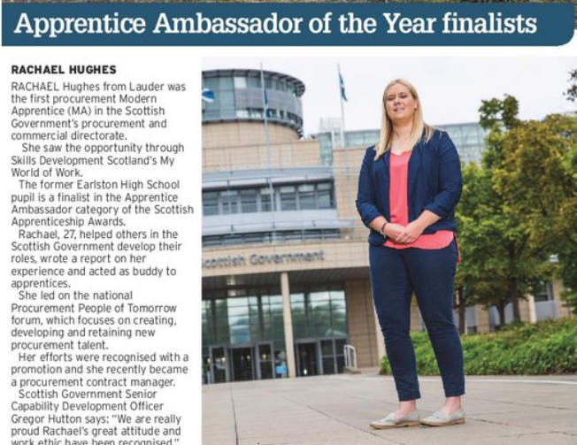
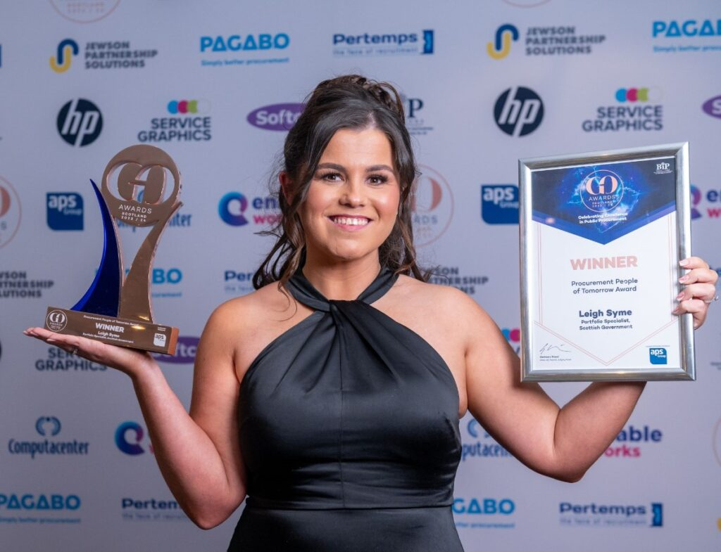
Progress of our people
Jack Graham
Procurement Modern Apprentice
Scottish Government
Jack is now a B2 Procurement Specialist in National Collaborative Procurement
Jack was a finalist for the GCF/SG Rising Star Award (Scotland) 2023
Rachael Hughes mcips
Procurement Modern Apprentice
Scottish Government
Rachael is now MCIPS qualified and C1 Engagement and Delivery Manager in Scottish Procurement
Rachael has been a finalist for Apprentice Ambassador the Year 2018 and the GCF/SG Rising Star Award (Scotland) 2023
Leigh Syme
Procurement Modern Apprentice
Scottish Government
Leigh is a B3 Senior Procurement Specialist in Procurement Services Division
Leigh won the GO Awards Scotland Procurement People of Tomorrow Award 2023
Gregor Hutton mcips
Career Change into Procurement Scottish Government
Gregor is now MCIPS qualified and C2 Procurement Capability Portfolio Manager in Scottish Procurement
Gregor leads on Scotland’s National Procurement Standards and the Commercial Training Programmes
Angus Mackenzie mcips
Procurement Modern Apprentice
Scottish Government
Angus is now MCIPS qualified and B3 Senior Procurement Specialist in Procurement Services Division
Sarah Pagan
Procurement Modern Apprentice
Scottish Government
Sarah is now a B3 Senior Procurement Specialist in Procurement Services Division
Jan 2026

