Slide 1

Call to Action
A 30-minute briefing
Note this webinar is being recorded and will be shared with the wider network afterwards
Can use the Q&A function if have any questions during the webinar

Slide 2
Purpose of this session
We have an IRES 2027+ proposition
This has been shown to Scottish Government
We are having on-going discussions on funding
Four Scalable options presented
Scottish Government have encouraged us to be vocal
Meeting with MSP Màiri McAllan and Alyn Smith in place
We’re going to show you how you can help

Slide 3
IRES 2027+ Our five key messages
Scottish Government investment has already built a Regional Skills Ecosystem. Losing it would be greater than the cost of sustaining it.
    Eight years building to connect employers, skills providers, local authorities and government around a shared economic mission
    We cannot afford to lose the strategic alignment, employer relationships and delivery capability that we have in place
Economic growth depends on Skills. Skills needs genuine, collaborative regional delivery.
    National policy sets direction, but growth happens in regional labour markets
    Scotland cannot achieve its ambitions of; higher productivity, net zero, AI adoption, growth in advanced manufacturing and public service reform without a skilled workforce

Slide 4
IRES 2027+ Our five key messages
Aligning local priorities and creating pathways out of poverty.
  By connecting local delivery with regional labour market demand, IRES creates clearer pathways into sustainable employment, supports progression into higher skilled, better paid work and
  Helps tackle poverty through inclusive economic growth.
Delivers on the direction of travel Scottish & UK Govts are pursuing.
  Public Service Reform in action. Stop SILO working and brings integration
  The IRES Ecosystem aligns national priorities with regional delivery, creating a single framework capable of connecting policy, investment and economic opportunity in a way that individual programmes cannot achieve alone.

Slide 5
IRES 2027+ Our five key messages
IRES27+ is Scotland's demonstrator for Regional Skills Reform.
  The most developed example of integrated regional employability and skills delivery in Scotland.
  Meets each of Scottish Governments key priorities:
    Growing the Economy
    Tackling Poverty
    Climate Emergency
    Stronger Public Services
“We are not asking Scottish Government to fund IRES beyond 2027 because it has been successful. We are asking Scottish Government to fund IRES beyond 2027 because Scotland’s economy needs what IRES has built.”
Ken Gourlay; Chief Executive, Fife Council and Chair IRES Board

Slide 6
Call to Action
Build a strong, visible and collective response from across the region
Showing the breadth of support for IRES27+
Ensuring Ministers hear directly from the projects and organisations who know the impact, opportunities and risks best.
We are therefore requesting that you write to Ministers to set out your support for continued investment in IRES27+.

Slide 7
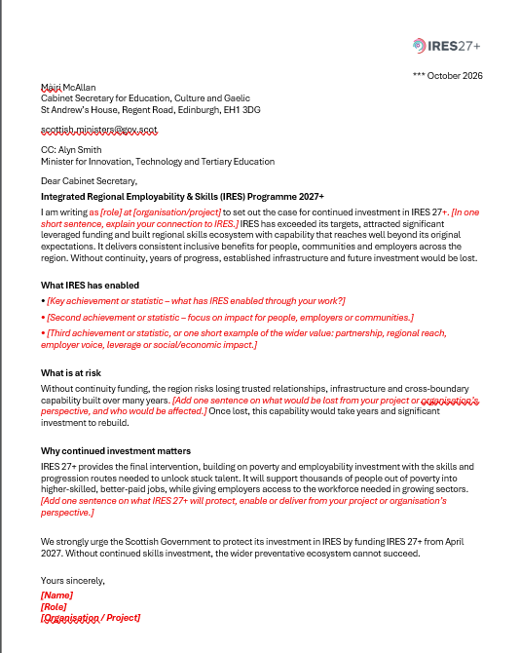
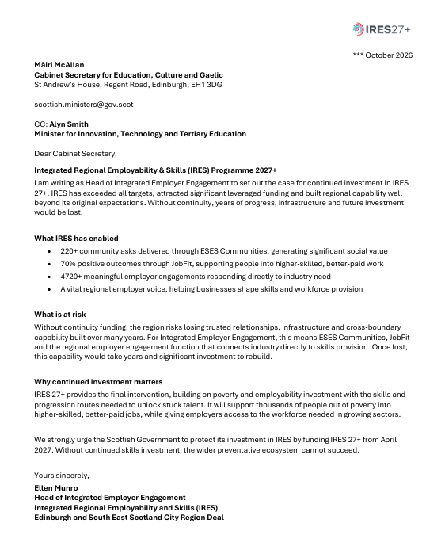
Stakeholder Template & Example
To make this as straightforward as possible, we have attached:
  IRES27+ Stakeholder Letter Template
  – a one page template you can adapt
  IRES27+ IEE Completed Example
  – to show the type & level of information that can be included

Slide 8
To Send:
Please make the letter your own and reflect your project or organisation’s experience. We recommend keeping it to one page and, where possible, including 2-4 strong achievements or statistics, what IRES has enabled, what would be at risk without continuity, and what future investment could enable. The template is there as a starting point and to make the process easier however please feel free to draft your own if you prefer.
STEP 1:
Letters are to be sent in PDF format as an attachment to an email.
Address your letter for the attention of (as shown in the examples):
  Màiri McAllan MSP
  Cabinet Secretary for Education, Culture and Gaelic
and request a copy to:
  Alyn Smith MSP
  Minister for Innovation, Technology and Tertiary Education
STEP 2:
Email to: scottish.ministers@gov.scot
Please cc:
  Adam.reid@gov.scot
  Christopher.thomson2@gov.scot
  Kimberley.daly@gov.scot
  IRES@capitalcitypartnership.org

Slide 9
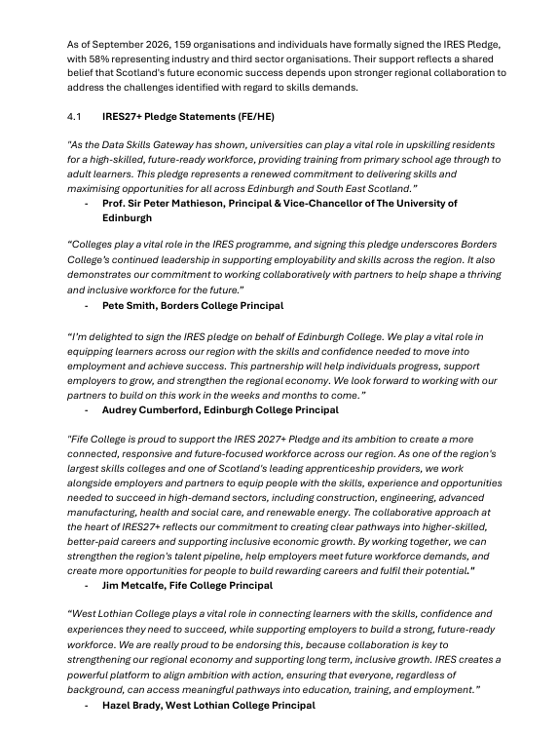
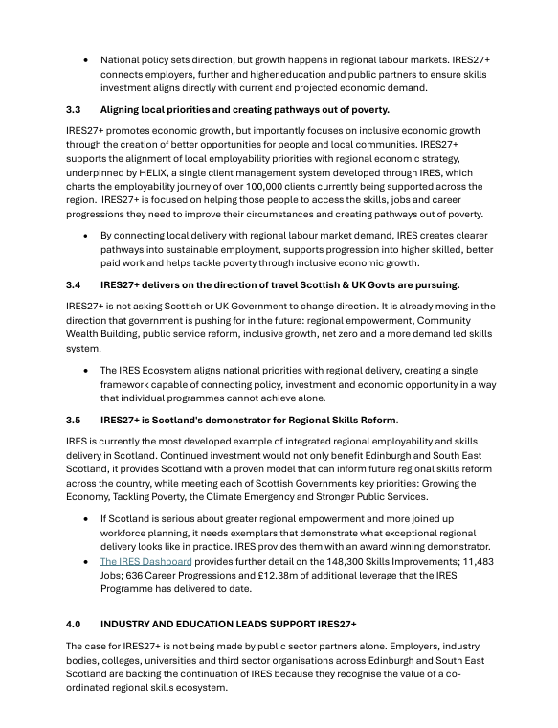
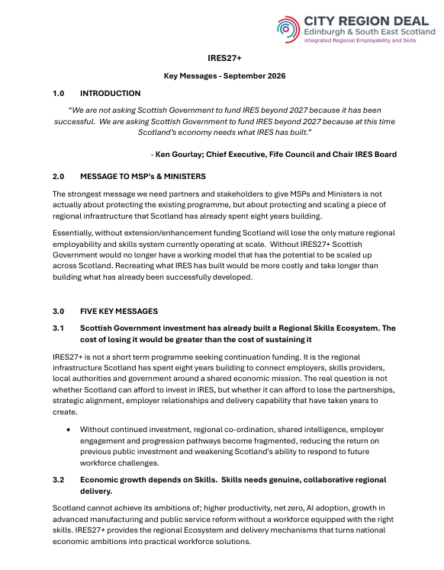
IRES27+ Key Messages
A short briefing to support any conversations you may have with decision-makers and help ensure our messaging remains clear and aligned.

Slide 10
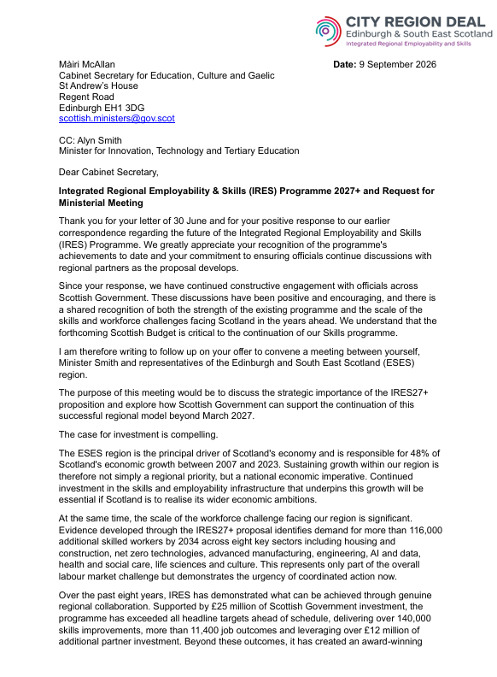
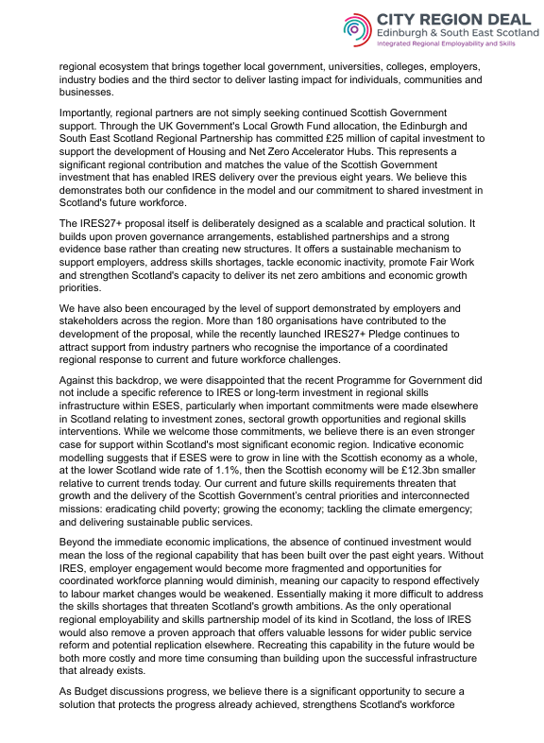
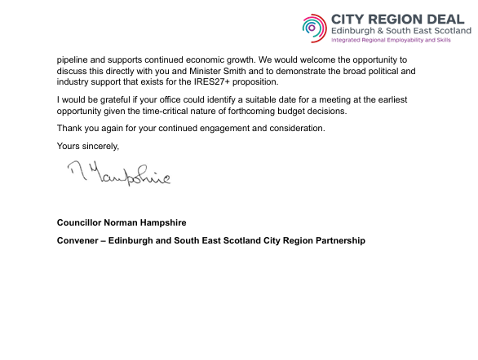
Letter to the Cabinet Secretary
Sent by Cllr Hampshire on behalf of the regional partnership, which may provide additional points or wording you find useful.

Slide 11
Ken’s Plea
At the recent IRES Event at Fife College – IRES Chair Ken Gourlay said:
“Please do not leave this event thinking that securing the future of IRES is someone else's job.
Think about your organisation, your networks and where you have influence. Think about the conversations you can have, the support you can offer and the case you can help us make over the coming months in the lead up to the Budget.
Funding decisions will not simply be won by documents and business cases. They will be won by a collective voice demonstrating the value, the demand and the impact of this programme.”

